Slide 1
MIDI Standard
Gabriel Rovesti - 2103389
July 3rd, 2024
Mobile Programming and Multimedia
2023-2024

Slide 2
Overview
MIDI: definition and representation
Types of information
Types of messages and structure
Channel/system messages
General MIDI mode
Devices and connections (with example)
Conclusions

Slide 3
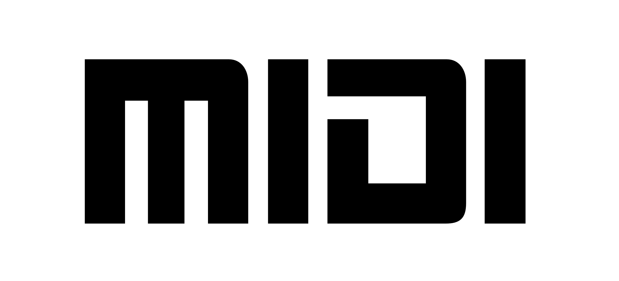
MIDI: what is it?
Source: midi.org
Communication protocol allowing electronic instruments to connect/exchange real-time data
Represents musical scores using a specific scripting language
Efficient compression, ideal for web and background music
Coding not completely standard and requires specific equipment
Mainly used for music composition and supports only western music

Slide 4
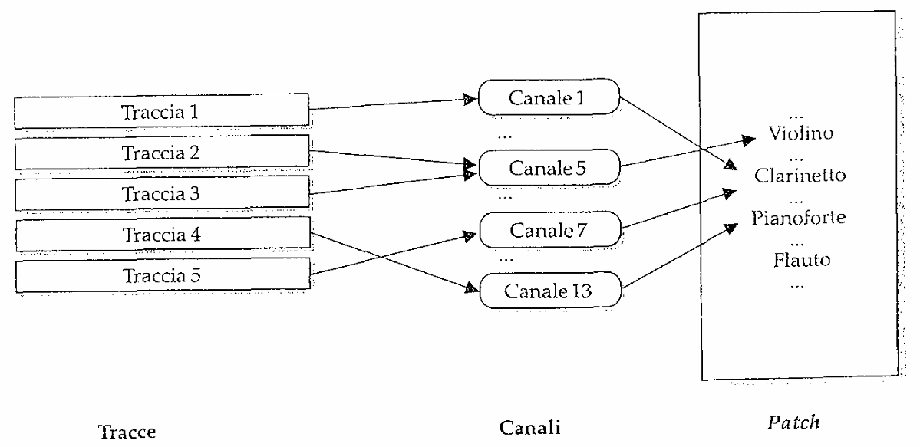
Types of information
Channels
Means through which send music events
Tracks
(Container of) Sequences of MIDI messages
Each track is associated to one or more channels
Patches
Pitch produced by a generator
Each channel is associated to one patch
Source: Audio e Multimedia – Valle/Lombardo

Slide 5
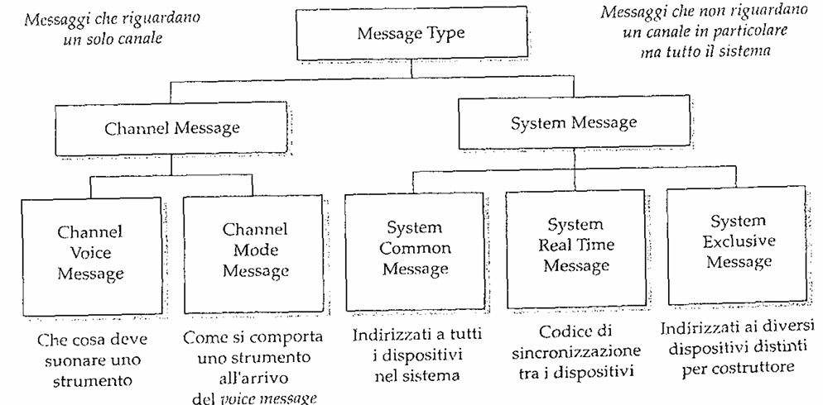
Types of messages
Source: Audio e Multimedia – Valle/Lombardo

Slide 6
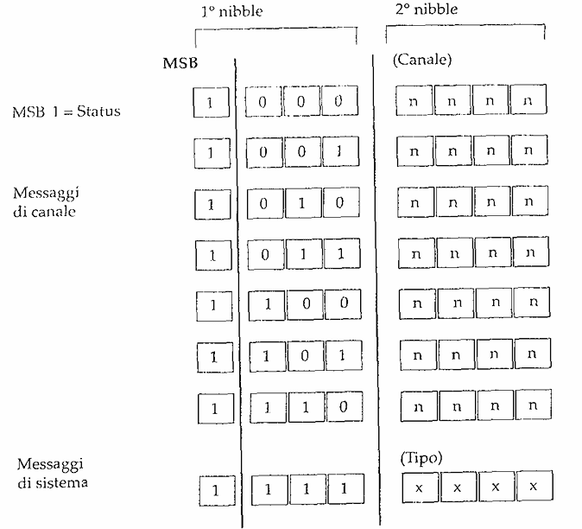
Structure of messages
Source: Audio e Multimedia – Valle/Lombardo

Slide 7
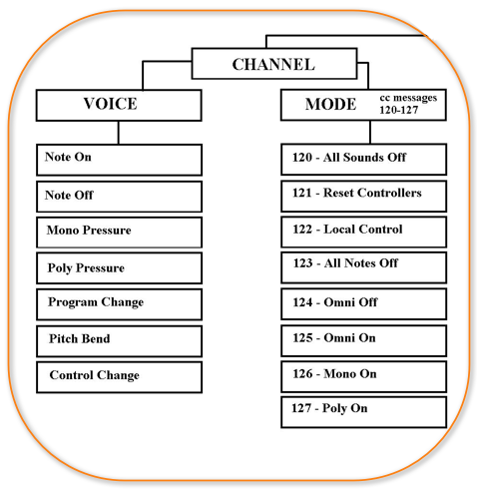
Channel messages
Voice messages
Musical events to be played by an instrument
There are different types
Note On / Note Off
Channel / Polyphonic Key Pressure
Pitch Bend / Program / Control Change
Mode messages
How an instrument behaves when voices messages arrive
There are different types
Omni On / Omni Off
Mono / Poly
Source: Wikiaudio

Slide 8
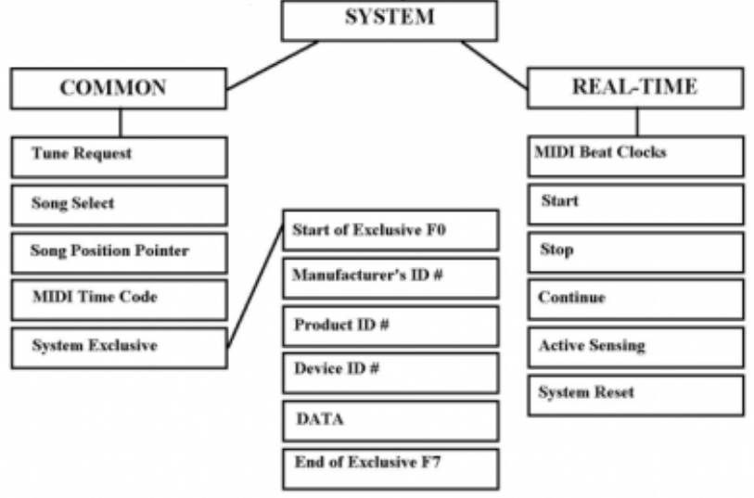
System messages
Common messages
General system functions across the system
There are different types
Song Select / Song Position Pointer
Tune Request
Real-time messages
Synchronization of different system modules
There are different types
MIDI Clock
System Reset
Start/Continue/Stop
Exclusive messages
Non-standard messages for specific manufacturers
Source: Wikiaudio

Slide 9
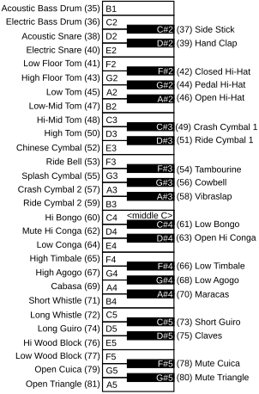
General MIDI Mode
Encoding specifying a priori channels/patches/timbres association
All compliant MIDI instruments meet a certain set of features and presets
GM attaches specific interpretations to many parameters
There is no standard way to associate patches to a particular channel
E.g., Roland/Yamaha defined their own internal standards
Source: Wikipedia

Slide 10
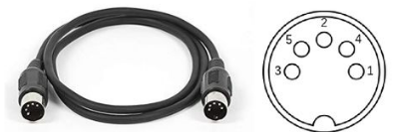
Devices and connections
MIDI also establishes which physical connections should be made (interfaces), via DIN connectors
There are three types of ports: In/Out/Thru
They can easily form a network providing interconnectivity between different devices (e.g., daisy chaining, Thru Boxes)
Source: MIDI 1.0 Specifications

Slide 11
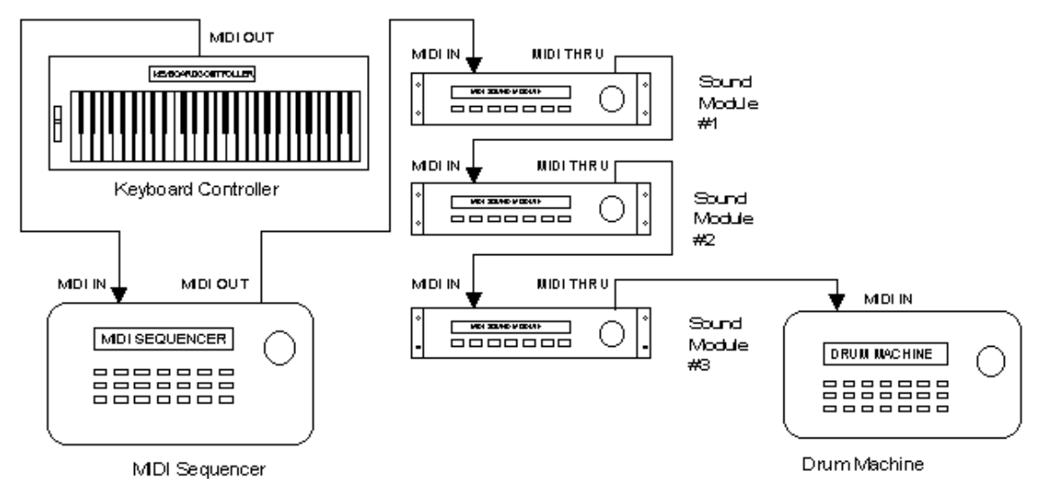
A MIDI System Example
Source: academictutorials.com

Slide 12

Conclusions
Pros
Very flexible and editable in instruments configuration
Files are very small and generally sound good
It allows for easy editing for both professionals/amateurs
Can be used both for modern and vintage technology
Cons
It depends on the quality of chosen playback devices
Encodes only standard music and uses only 60 channels
Limited addressing with 16 channels
Requires specific hardware

